Slide 1
On-road Mobile Source Emission Inventory Data Analysis
Mohammad Hashem Askariyeh
February 11th, 2021

Slide 2
Contents
The electric light-duty vehicles (ELDVs) population change statewide (2020 to 2050)
The mileage accrual rate distribution of gasoline light-duty vehicles (GLDVs) by age
The air basin with highest NOx emission from diesel-fueled medium heavy-duty trucks (MHDTs)
The NOx emission rate of heavy heavy-duty trucks (HHDTs)
The statewide heavy heavy-duty trucks (HHDTs) NOx emission changes from 2020 through 2050 with and without the proposed regulation
The inconsistencies that might indicate issues with the quality of the data

Slide 3
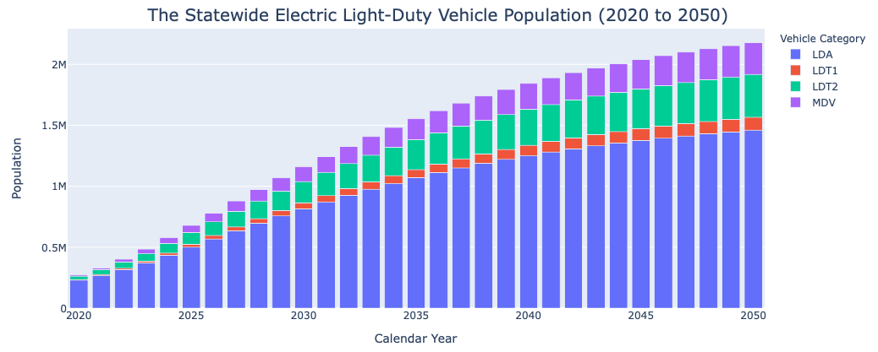
The electric light-duty vehicles (ELDVs)
Notes:
Q1a.html

Slide 4
The electric light-duty vehicles (ELDVs)
In 2020, Los Angeles county has the highest number of electric light duty vehicles (ELDVs count: 69,766)
In 2050, Los Angeles county has the highest number of electric light duty vehicles (ELDVs count: ﻿506,028)
A 625% increase in ELDVs count in Los Angeles county

Slide 5
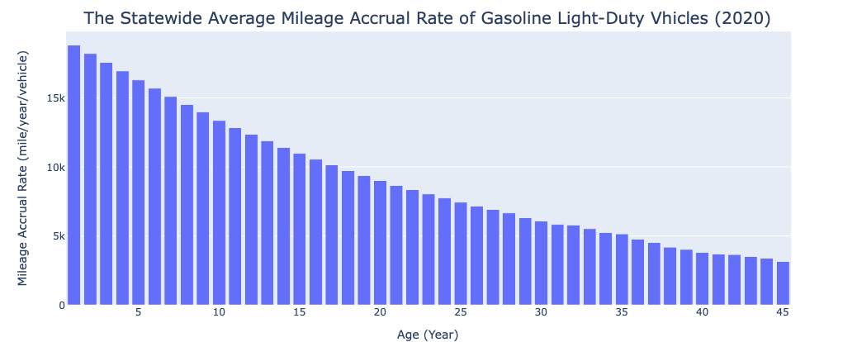
The mileage accrual rate distribution
Notes:
The mileage accrual rate from 18835 k miles for 1 years old cars decreases to about 3k miles for 45 years old ones.
Q2_2.html

Slide 6
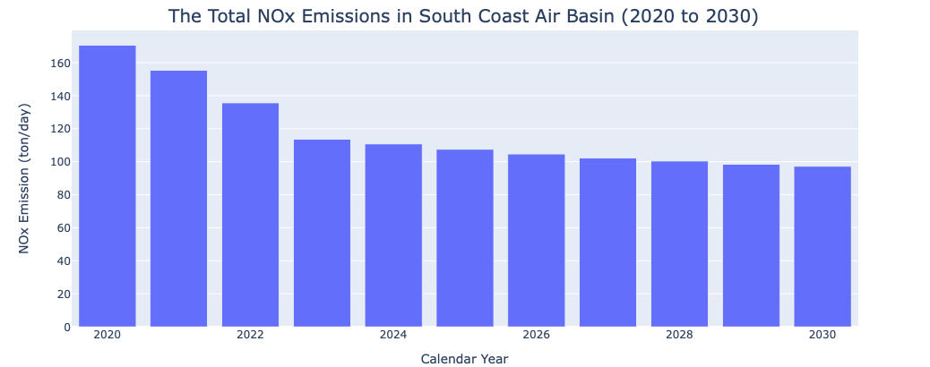
NOx emission from diesel-fueled medium heavy-duty trucks (MHDTs)
The South Coast air basin is the largest contributor of MHDT NOx emissions in 2030 with 15.7 tons per day
Notes:
It reduces from 170.5 ton/day in 2020 to 97.127 ton/day
Q3b_1.html

Slide 7
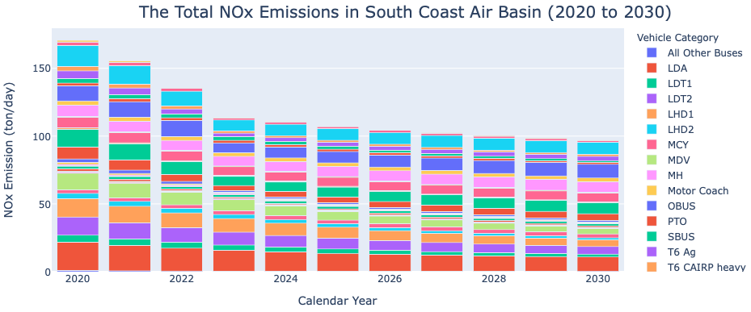
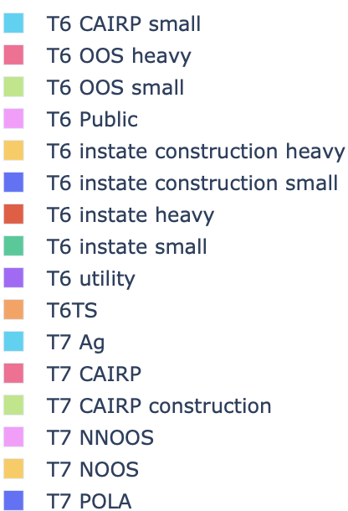
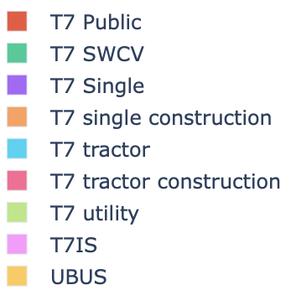
The total NOx emission in South Coast air basin
Notes:
It reduces from 170.5 ton/day in 2020 to 97.127 ton/day
Q3b_2.html

Slide 8
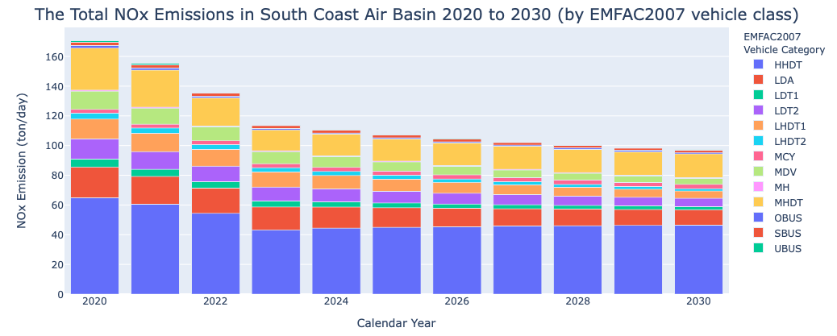
The total NOx emission in South Coast air basin
Notes:
EMFAC2007 vehicle classes: HHDT, MHDT, and LDA are the top contributors.
Q3c_1.html

Slide 9
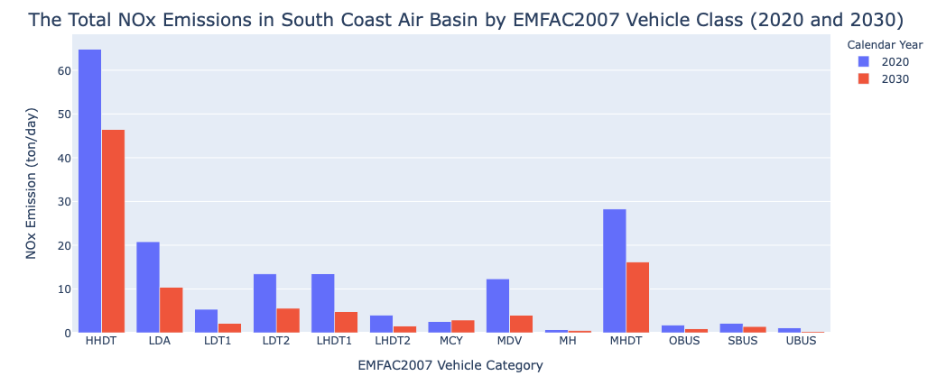
The total NOx emission in South Coast air basin
Notes:
Q3C_2.html

Slide 10
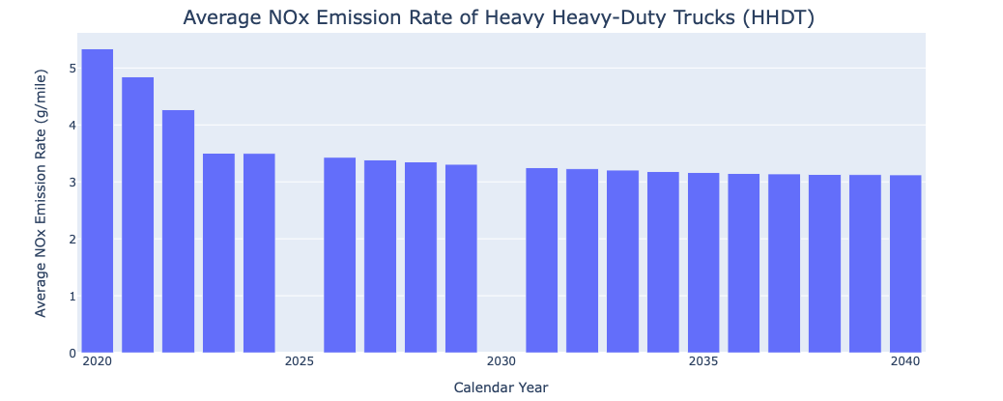
NOx emission rate of heavy heavy-duty trucks (HHDTs)
Notes:
Q4-
From 5.33 g/mile decreases to 3.2 after 2030 and the 3.1 in 2040.
The air basin with highest HHDT NOx emission factor in 2035: MARIPOSA COUNTY APCD with weighted_NOx 5.2
Q4a_2.html

Slide 11
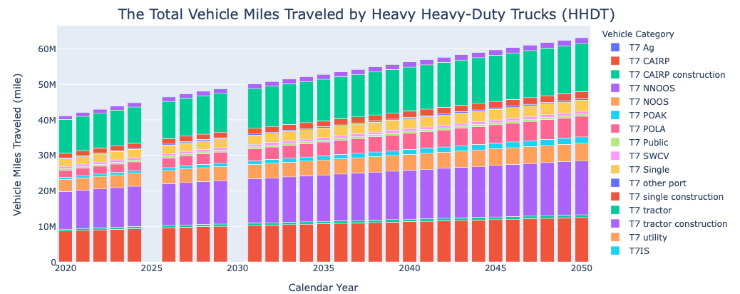
Miles traveled by heavy heavy-duty trucks (HHDTs)
Notes:
Significant increase in HHDT miles traveled from 2020 to 2050.
Significance of T7 Tractors, T7 NNOOS, T7 CAIRP
Q4a_vmt.html

Slide 12
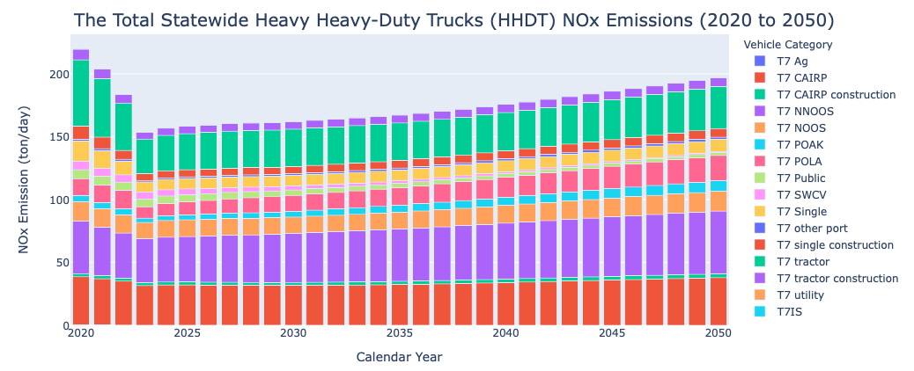
The statewide heavy heavy-duty trucks (HHDTs) NOx emission
Notes:
Q5a.html

Slide 13
The statewide heavy heavy-duty trucks (HHDTs) NOx emission with proposed plan
The proposed Advanced Clean Trucks regulation (excluding out-of-state trucks):
The reduction percentages for each model year
Model Year | % of zero-emission trucks
2024 | 25%
2025 | 25%
2026 | 50%
2027 | 50%
2028 | 50%
2029-2050 | 100%

Slide 14
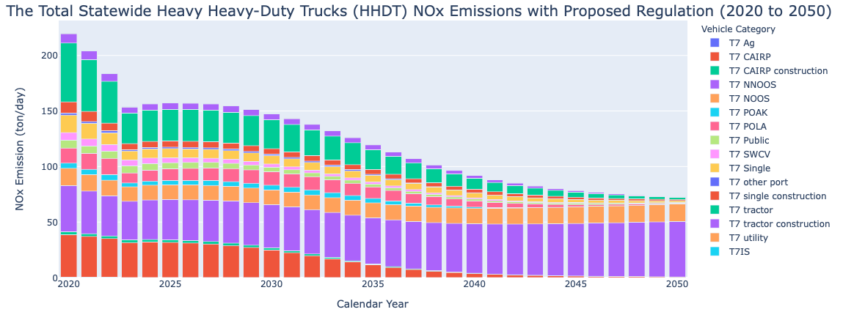
The statewide heavy heavy-duty trucks (HHDTs) NOx emission with proposed plan
Notes:
Q5b_1.html

Slide 15
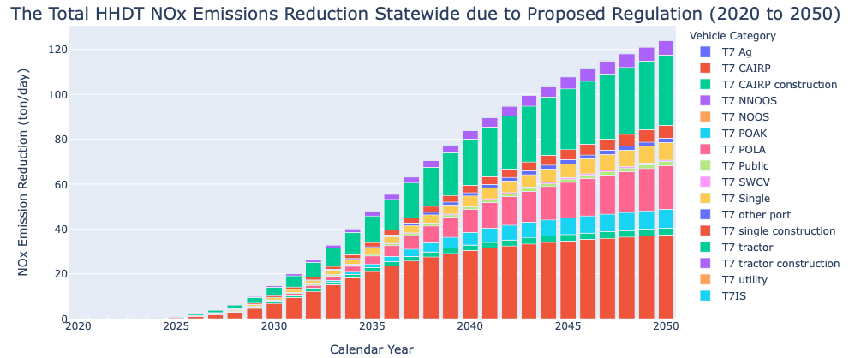
The statewide heavy heavy-duty trucks (HHDTs) NOx emission with proposed plan
Notes:
Q5b_2.html

Slide 16
The inconsistencies that might indicate issues with the quality of the data
Different format in EMFAC data files, some had 5 lines above the header, others have 6 lines.
Some records with non-zero daily emissions had zero VMT, missing records for HHDT VMT in years 2025 and 2030.
Population values could be integer.

Slide 17
Thank You!
Mohammad Hashem Askariyeh
mh.askariyeh@gmail.com

